Slide 1
Introduction to Microprocessor
Md. Shafqat Talukder Rakin
Lecturer, Department of CSE,
United International University
Email id : shafqat@cse.uiu.ac.bd
Courtesy: Nasif M. Sir

Slide 2
Overview of microcomputer
structure and operation
2

Slide 3
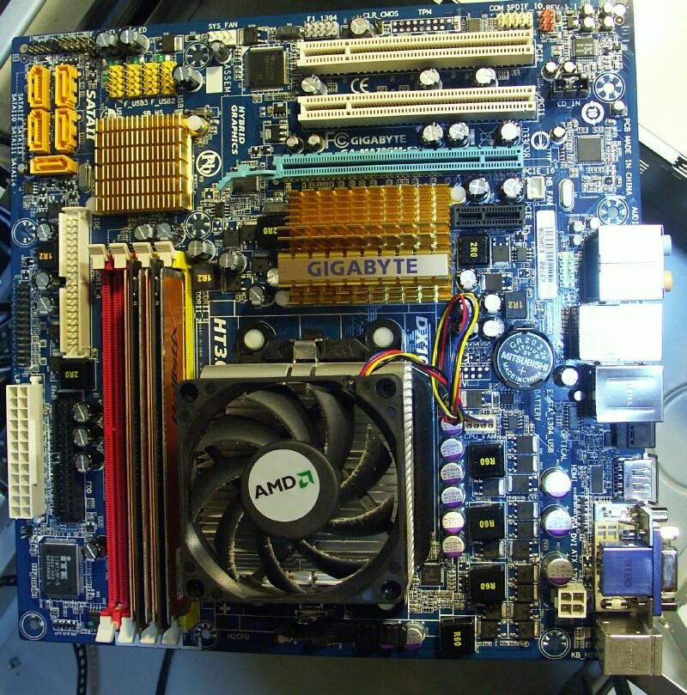
3

Slide 4
What are we going to learn
Microprocessor and Interfacing
Microcomputer
8086 microprocessor
Interfacing
Microcontroller
ATMEGA32
Serial Protocols
4

Slide 5
Major Parts Of a Microcomputer
CPU
Memory
Input / Output circuitry
Buses:
Address bus
Data bus
Control bus
5

Slide 6
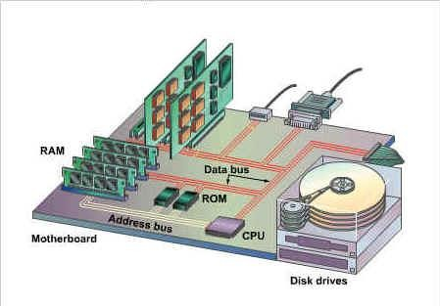
Micro-computer overview
6

Slide 7
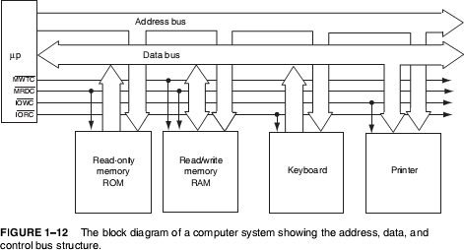
7

Slide 8
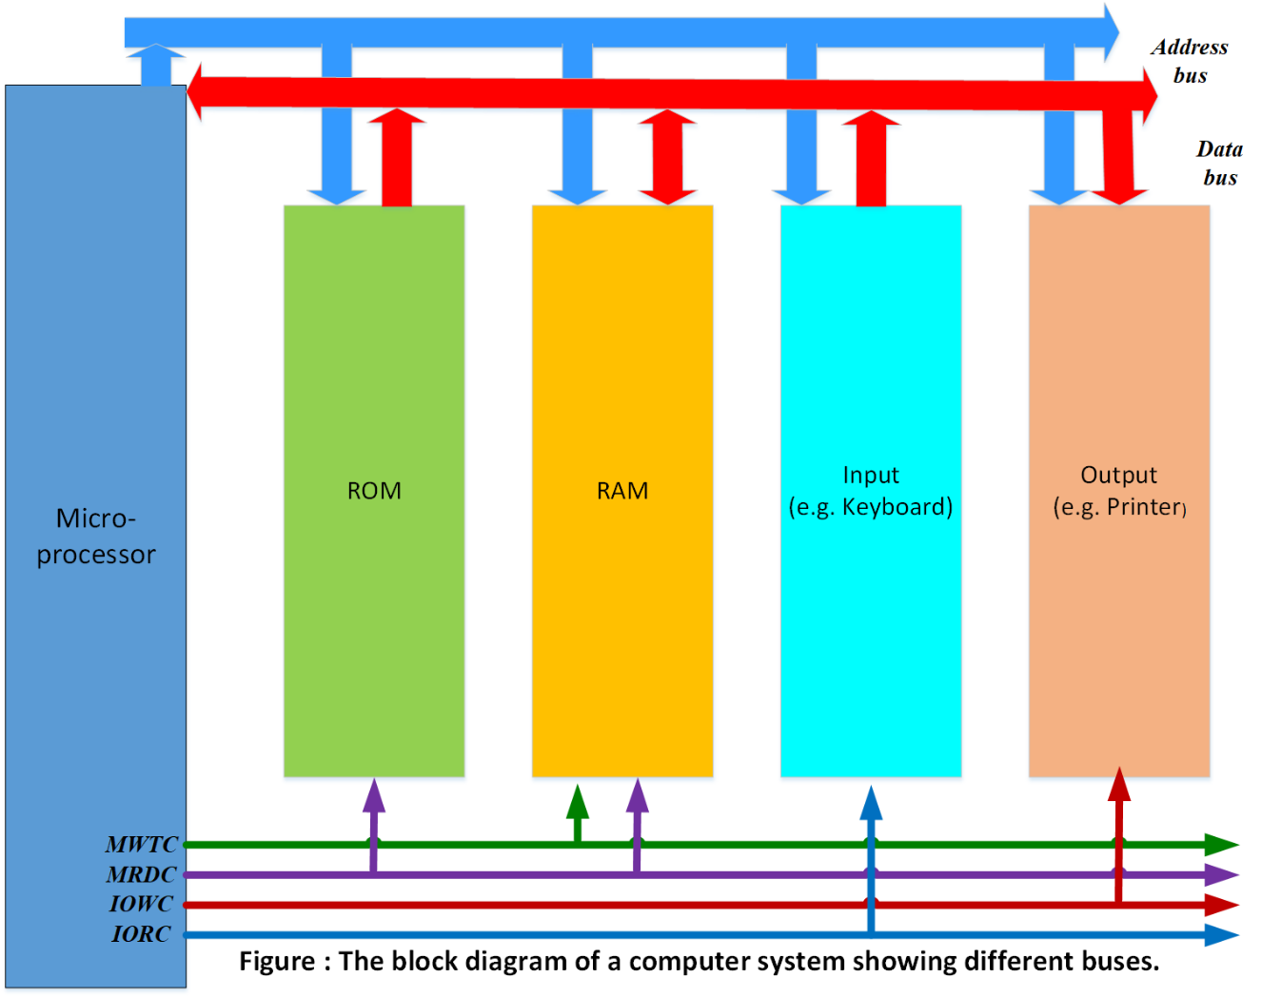
8

Slide 9
Central Processing Unit (CPU)
It controls the operation of computer
The CPU fetches binary-coded instructions from memory
Decodes the instructions into a series of simple actions
Carries out these actions in a sequence of steps

Slide 10
Input / Output
They are used to take data from outside world or send data to the outside world
I/O devices are connected with microprocessor through I/O ports
Example: Keyboards, video display terminals, printers, modems

Slide 11
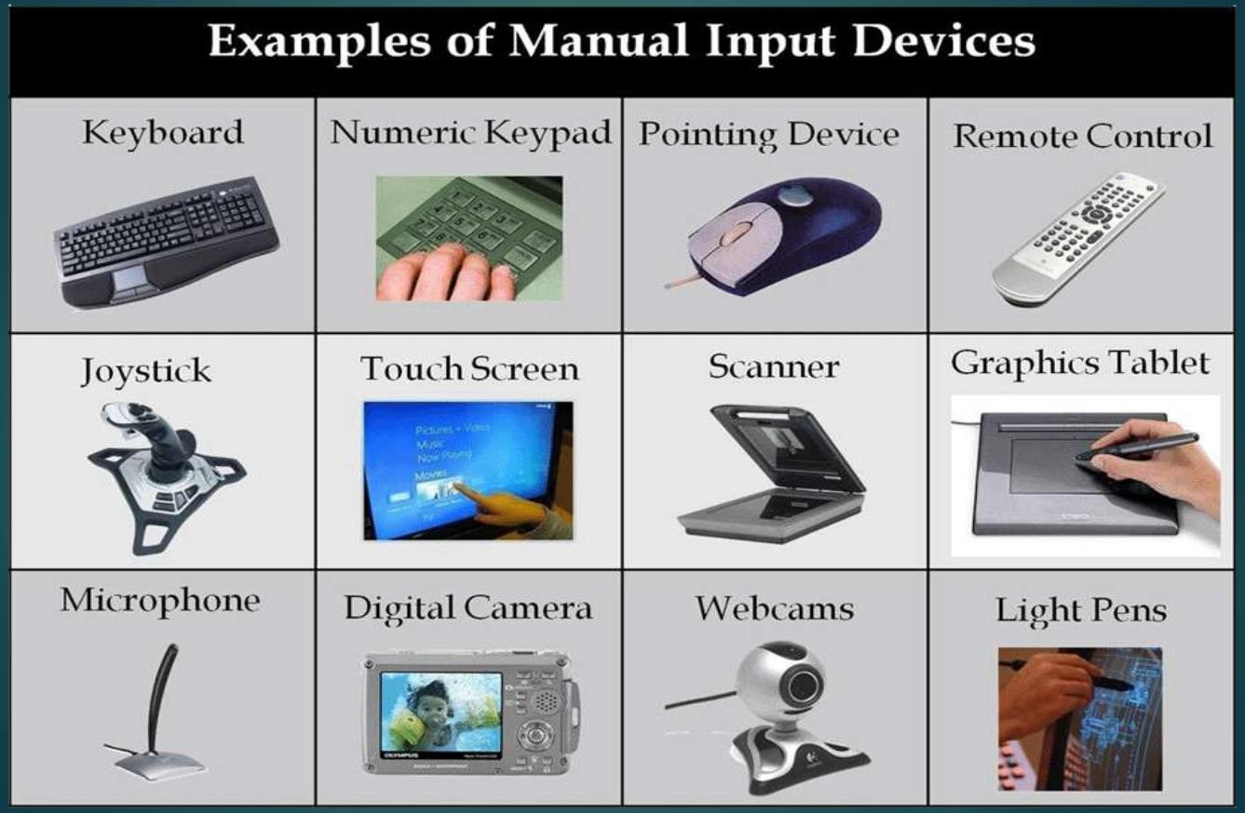

Slide 12
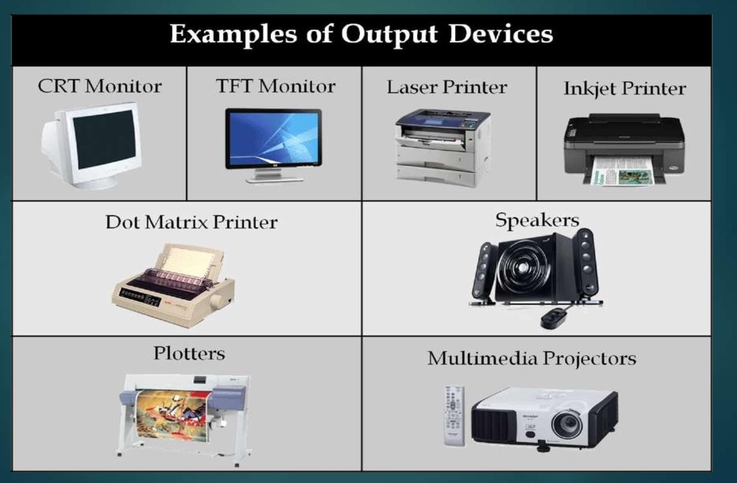

Slide 13
Memory
It stores the binary codes for the sequences of instructions
It stores binary coded data
Example: ROM, RAM, magnetic / optical disks

Slide 14
Memory Organization:
Processor memory
Primary or main memory
Secondary memory

Slide 15
Processor Memory:
It refers to the microprocessor registers which are used to hold temporary results when computation is in progress
No speed disparity between these registers and microprocessor because they are fabricated using the same technology
Costly

Slide 16
Primary Memory
This is the storage area in which all programs are executed
The microprocessor can directly access only those items that are stored in primary memory
All programs and data must be within the primary memory prior to execution
Example: ROM, RAM

Slide 17
Secondary Memory
It stores program and data in excess of main memory
Microprocessor can not directly execute programs which are stored in secondary memory
In order to execute these programs, the microprocessor must transfer them to its main memory by a system program called operating system
Example: Floppy disk, Hard disk etc.

Slide 18
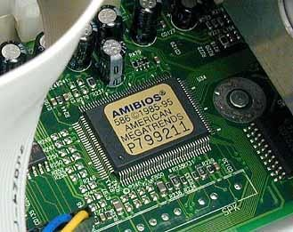
Figure: ROM

Slide 19
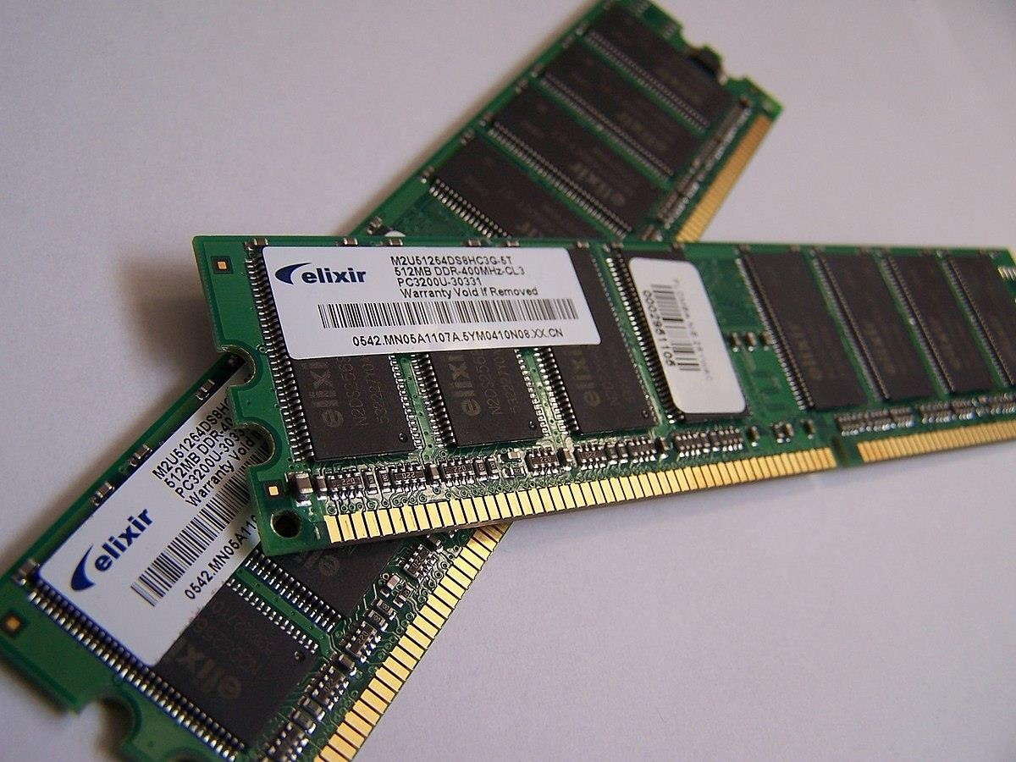
Figure: RAM
18

Slide 20
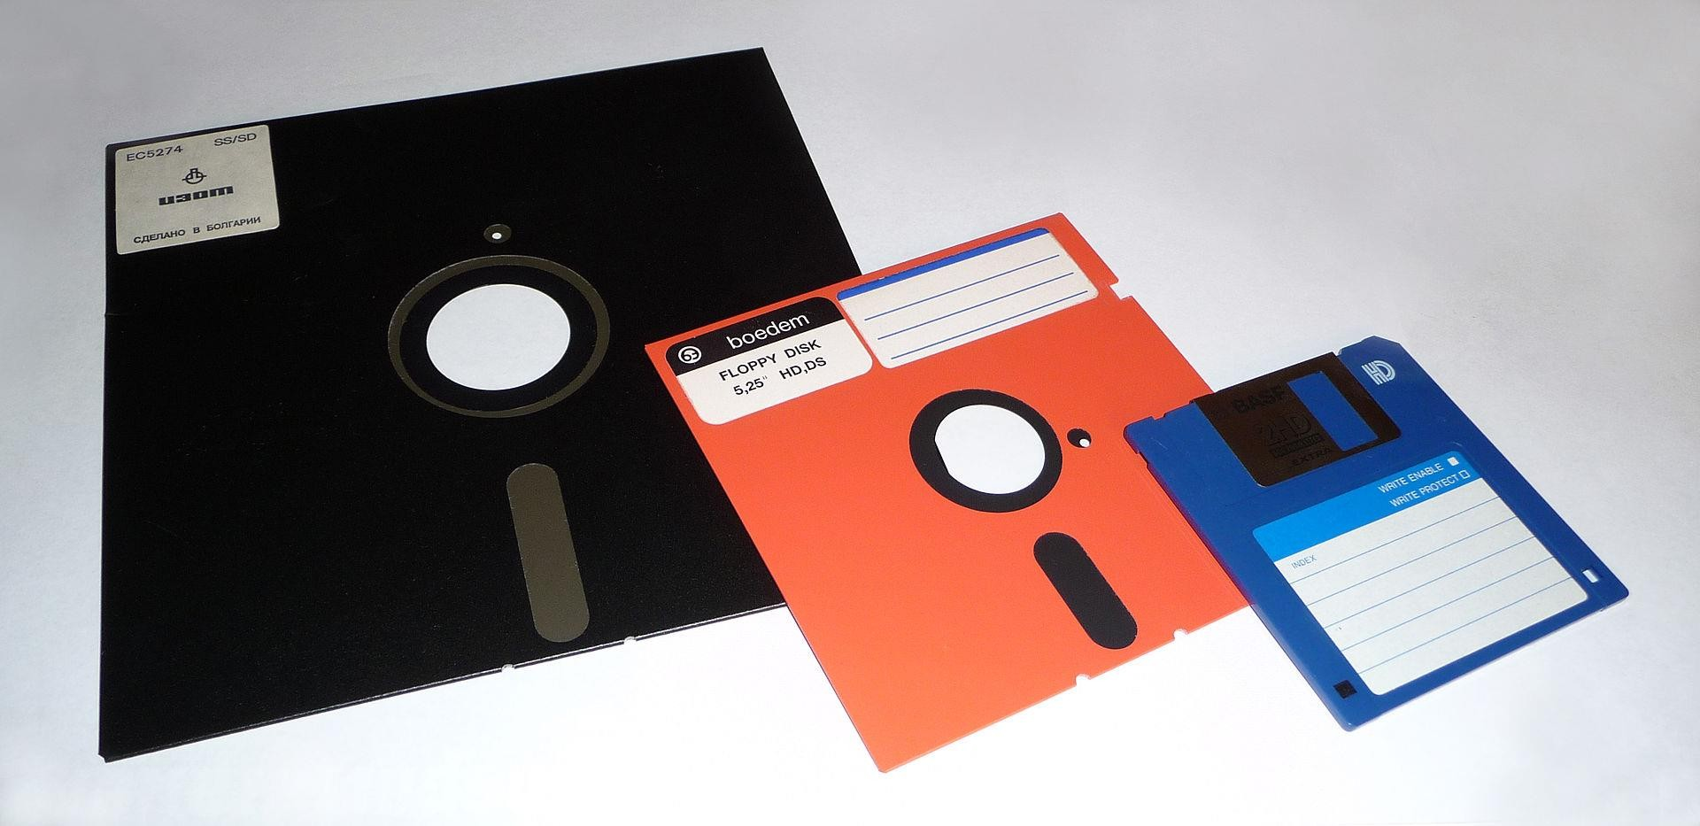
Figure: Floppy Disk
19

Slide 21
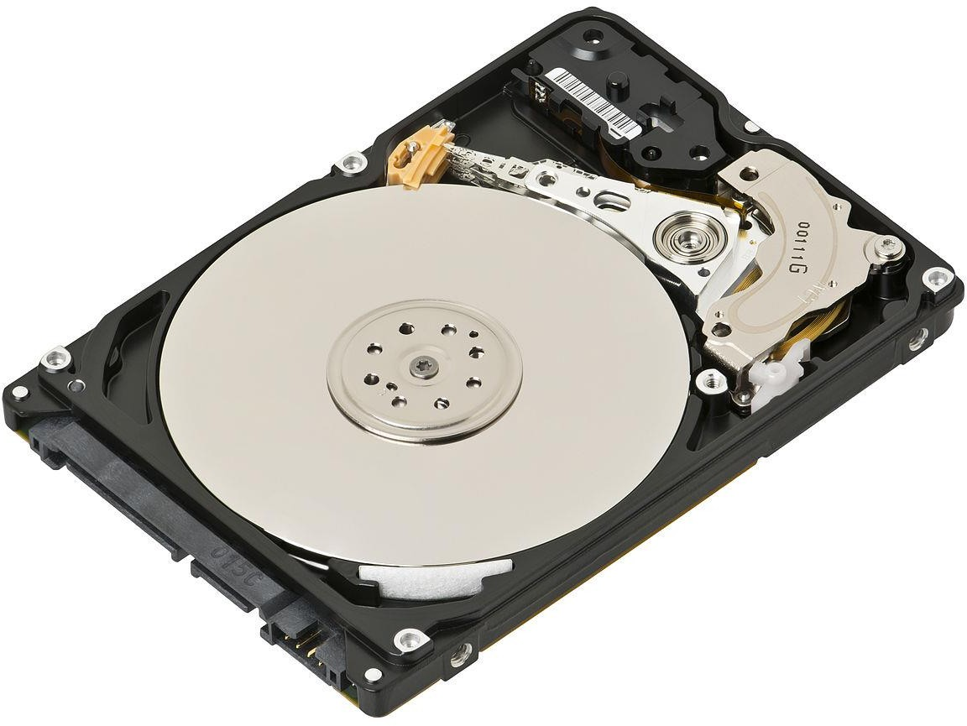
Figure: Hard Disk
20

Slide 22
BUS
The bus is an electrical path that connects the CPU, memory, and the other hardware devices on the motherboard.
The bus is a group of parallel wires.
The number of wires in the bus affects the speed at which data can travel between hardware components, just as the number of lanes on a highway affects how long it takes people to reach their destinations.
Because each wire can transfer 1 bit of data at a time, an 8-wire bus can move 8 bits at a time, which is a full byte. A 16-bit bus can transfer 2 bytes, and a 32-bit bus can transfer 4 bytes at a time. Newer model computers have a 64-bit bus, which transfers 8 bytes at a time.

Slide 23
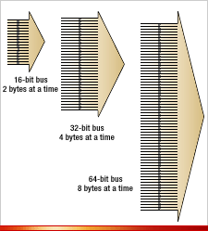
Figure: BUS
With a wider bus, the computer can move more data in the same amount of time (or the same amount of data in less time).

Slide 24
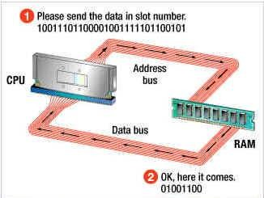

Slide 25
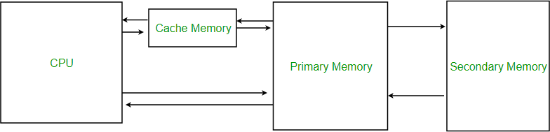

Slide 26
Address Bus
The address bus is a set of wires. It consists of 16, 20, 24, 32 or 36 parallel unidirectional signal lines
On these lines the CPU sends out the address of the memory location or I/O port that is to be written to or read from
The number of locations that the CPU can address is determined by the number of address lines

Slide 27
Data Bus
The data bus is a set of wires which consists of 8, 16, 32 parallel bidirectional signal lines
Many devices in the system will have their output connected to data bus, but only one device at a time will have its output enabled

Slide 28
Control Bus
The control bus is a set of wires which consists of 4 to 10 parallel signal lines
The CPU sends out signals on the control bus to enable the outputs of addressed memory devices or I/O devices
Example of control signals: Memory read, Memory write

Slide 29
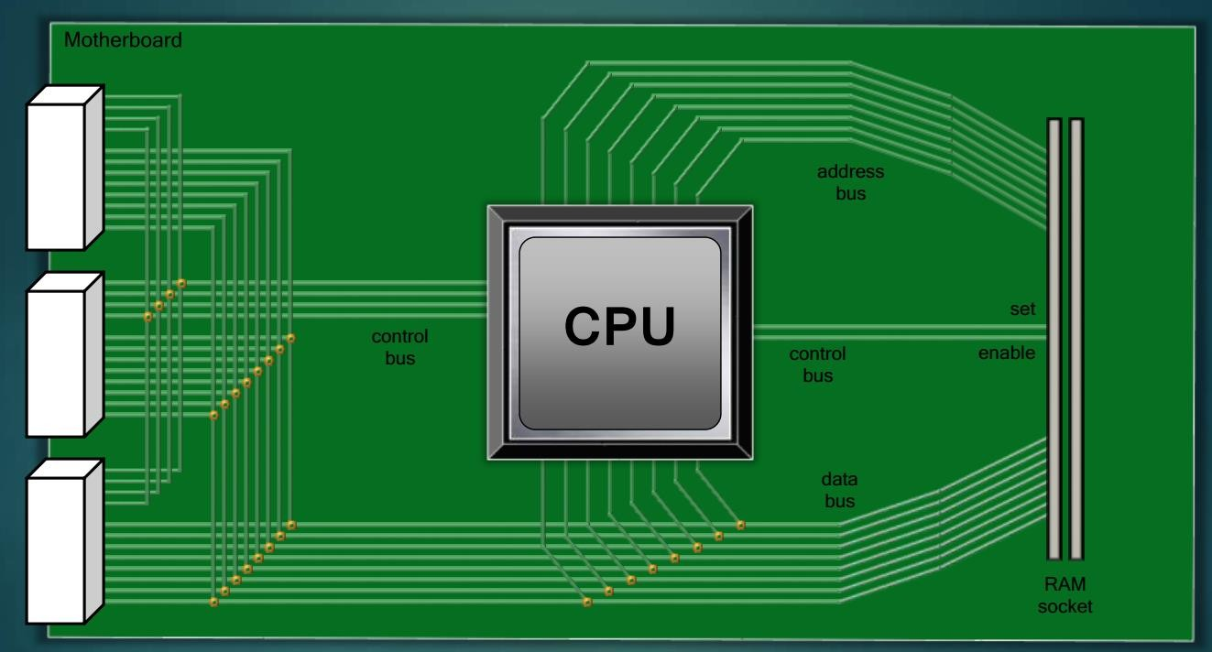

Slide 30
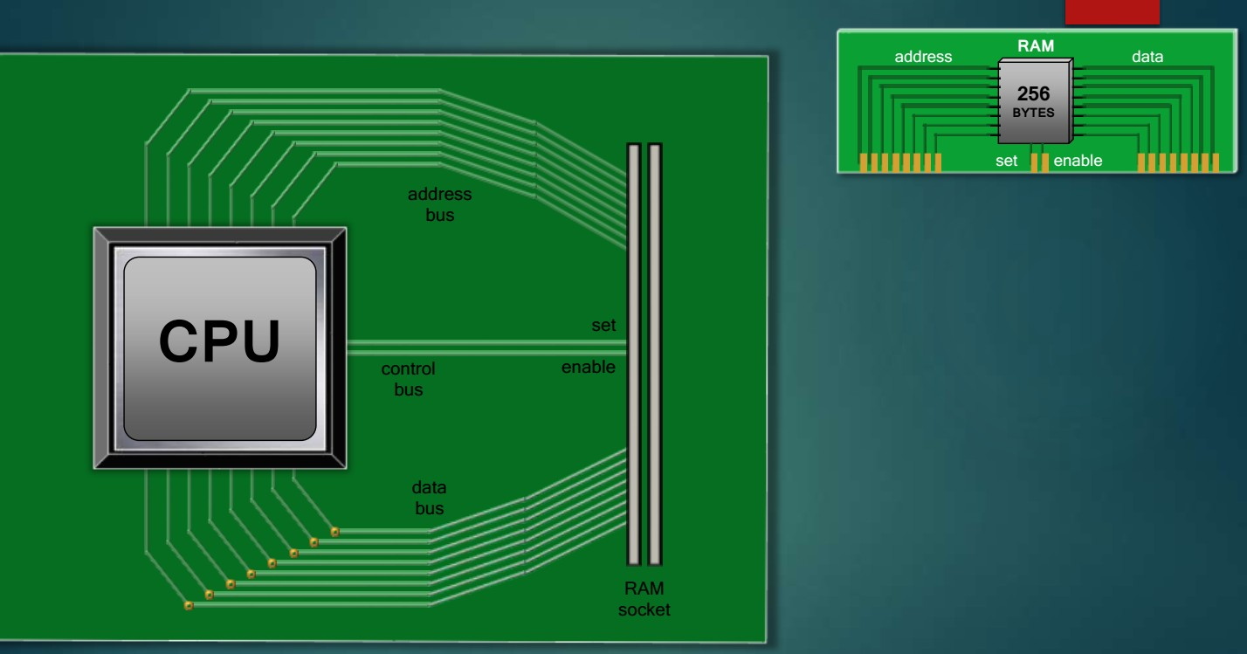

Slide 31
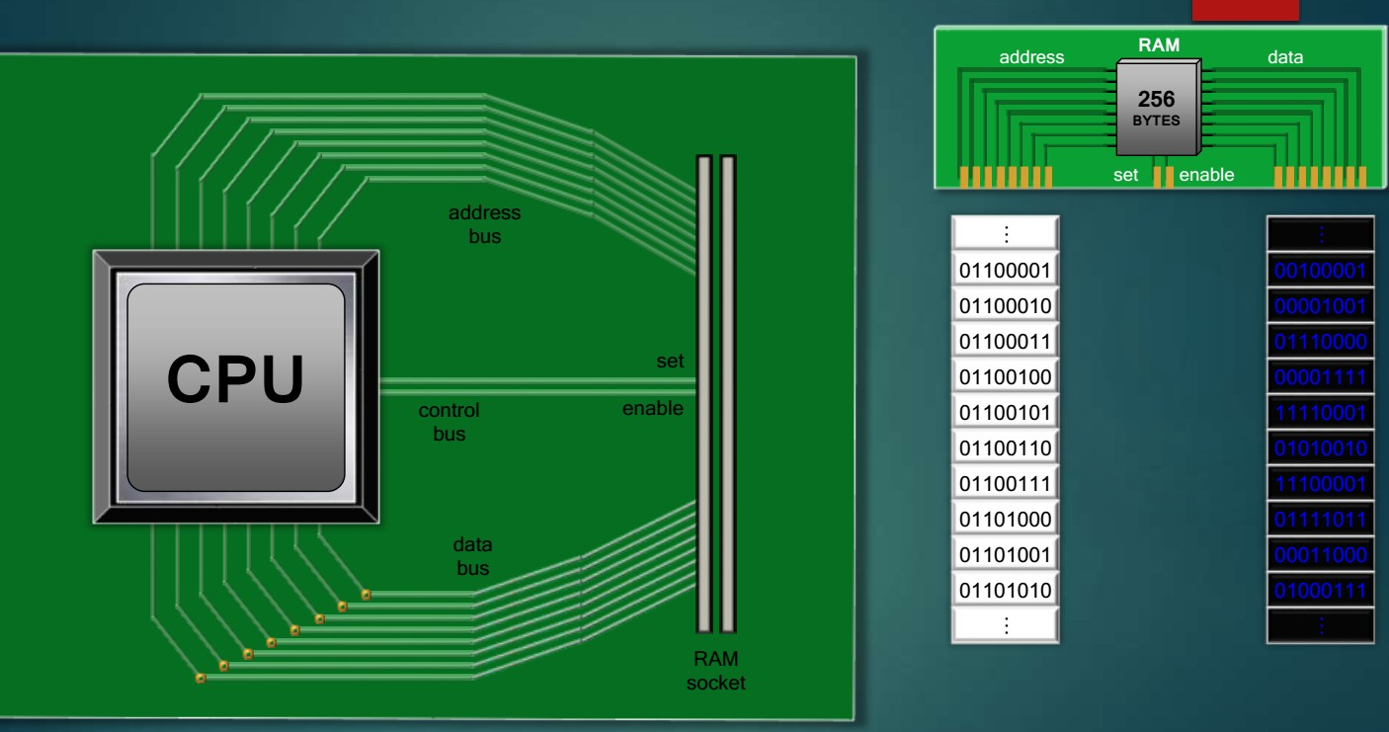

Slide 32
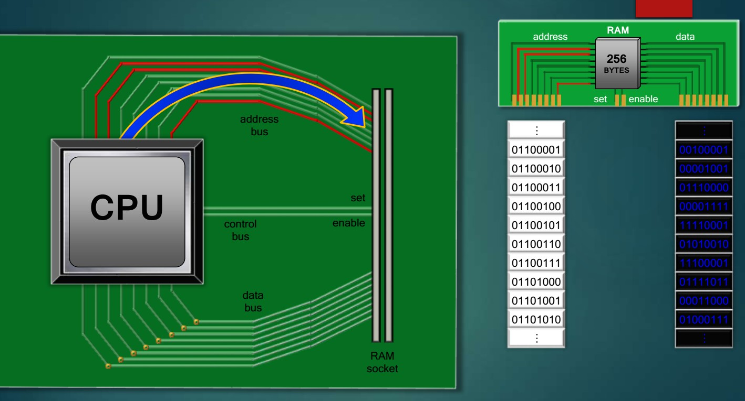

Slide 33
